Slide 1

Database Design & Implementation

Slide 2

Outline

Slide 3
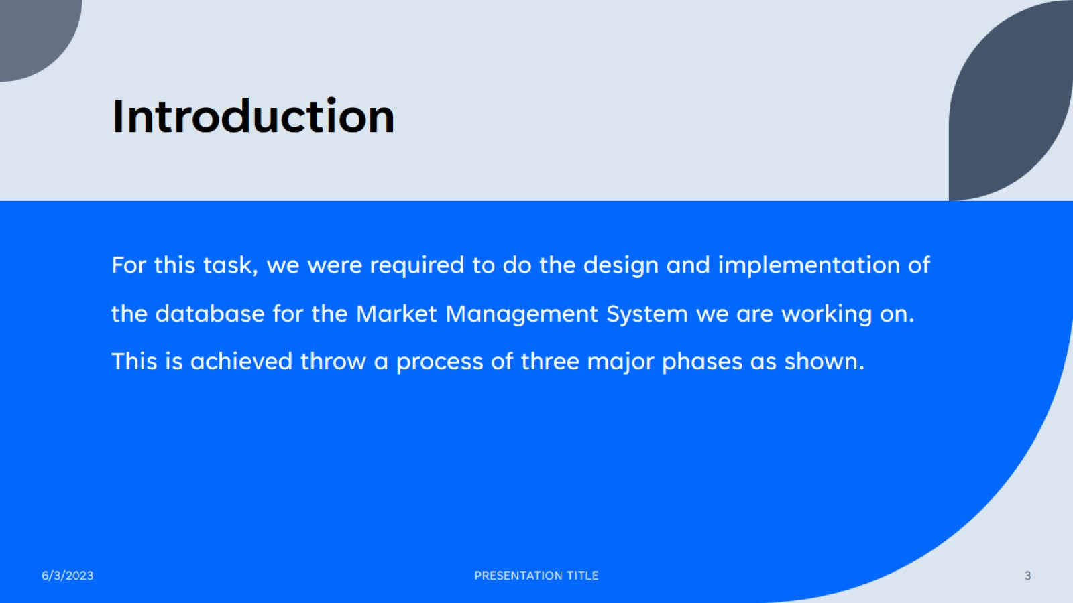
Introduction

Slide 4
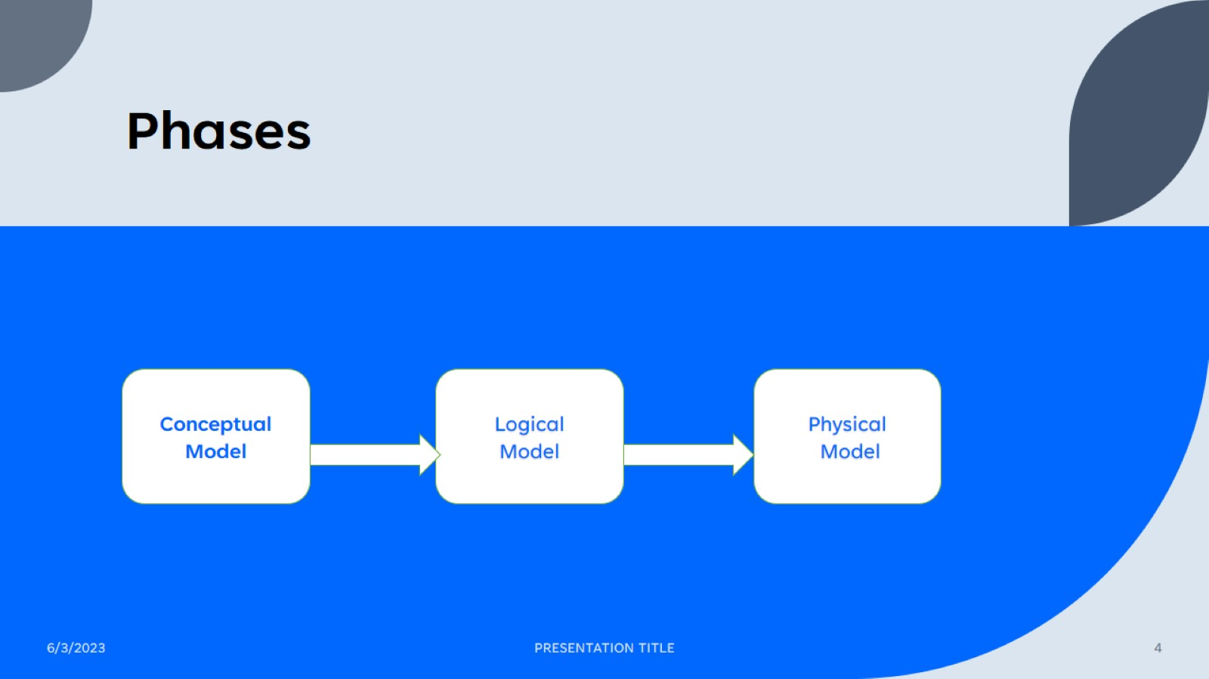
Phases

Slide 5
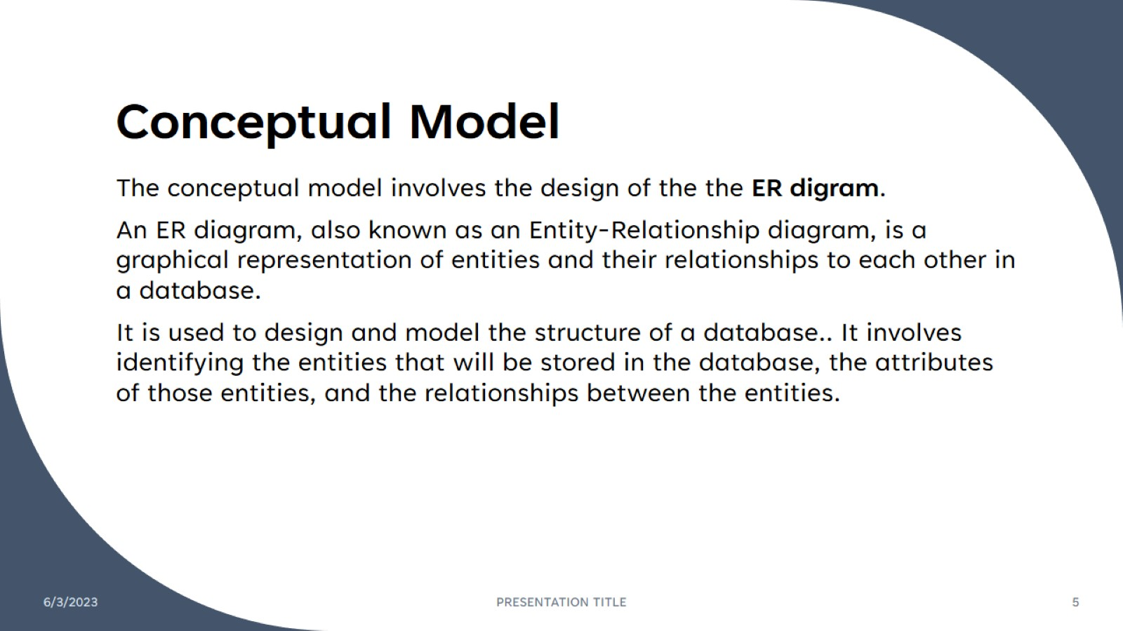
Conceptual Model

Slide 6
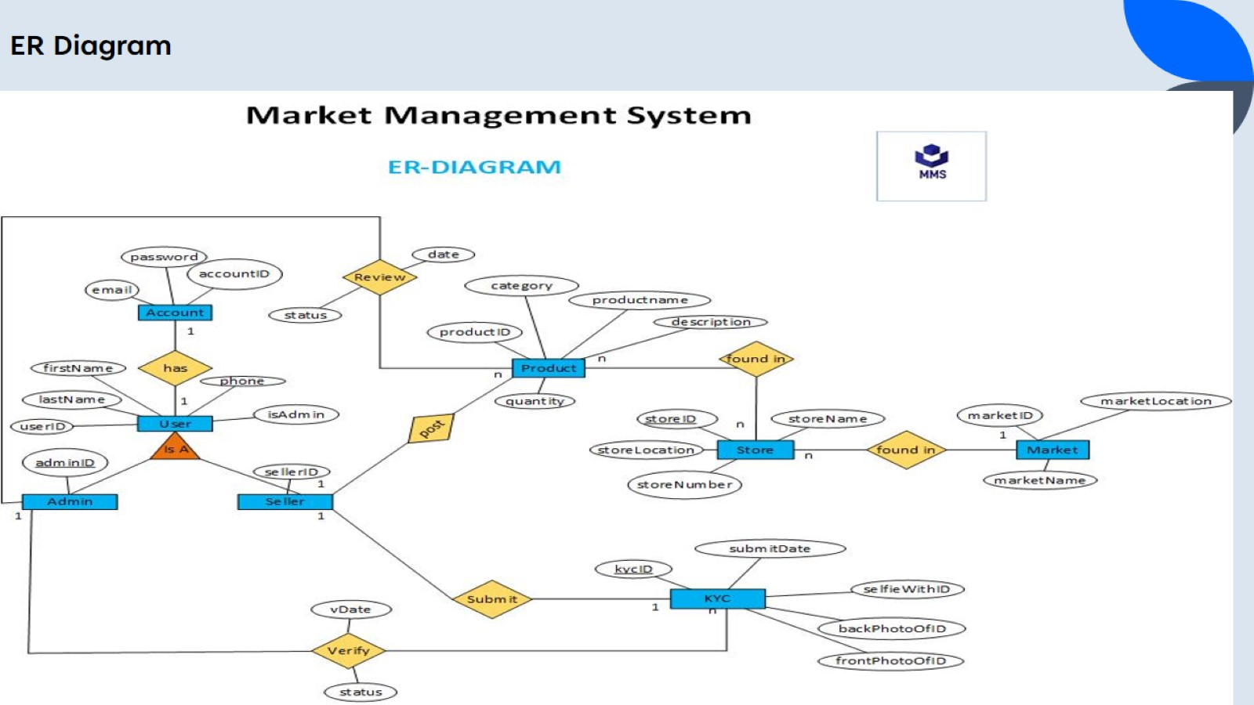
ER Diagram

Slide 7
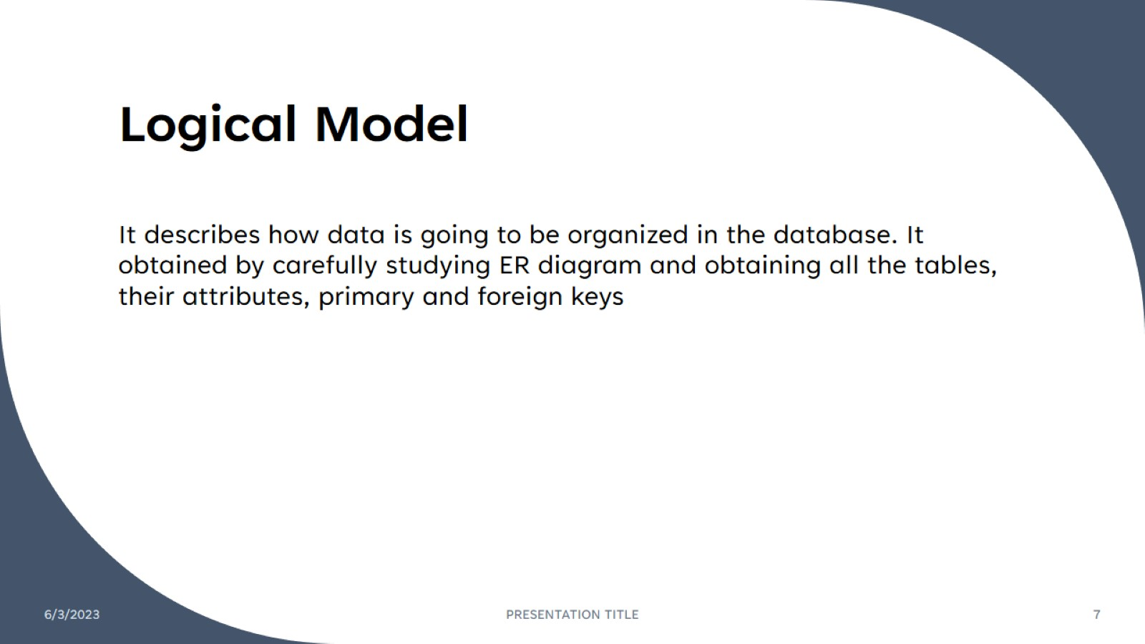
Logical Model

Slide 8
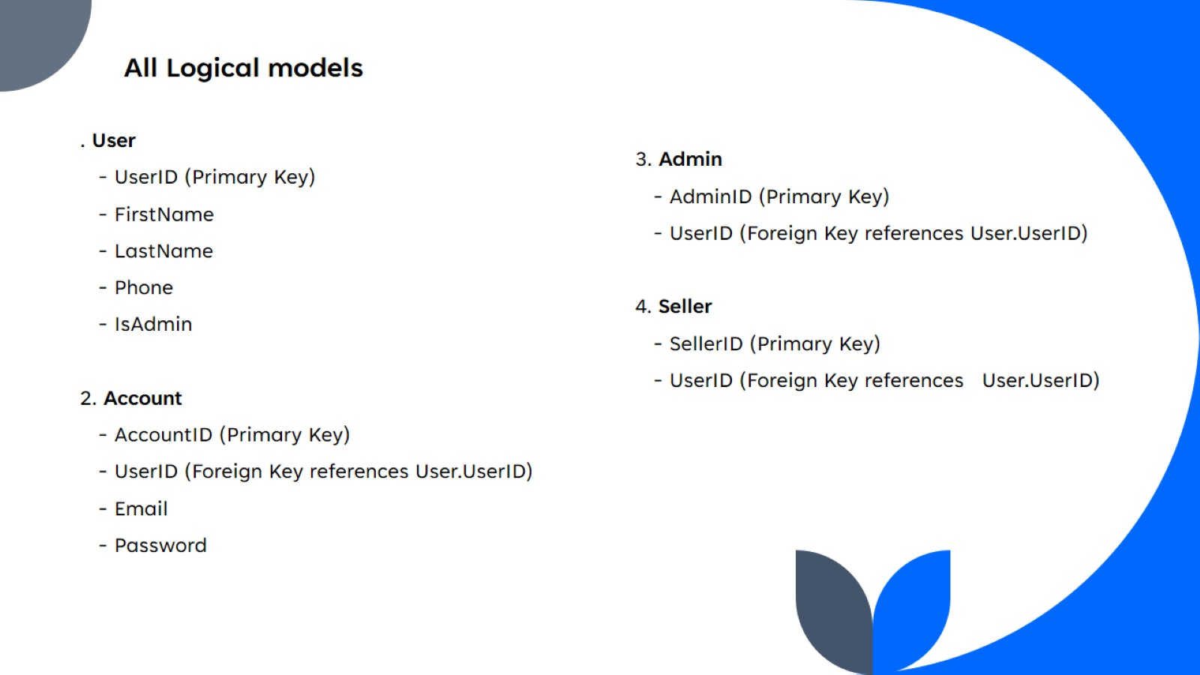
All Logical models

Slide 9
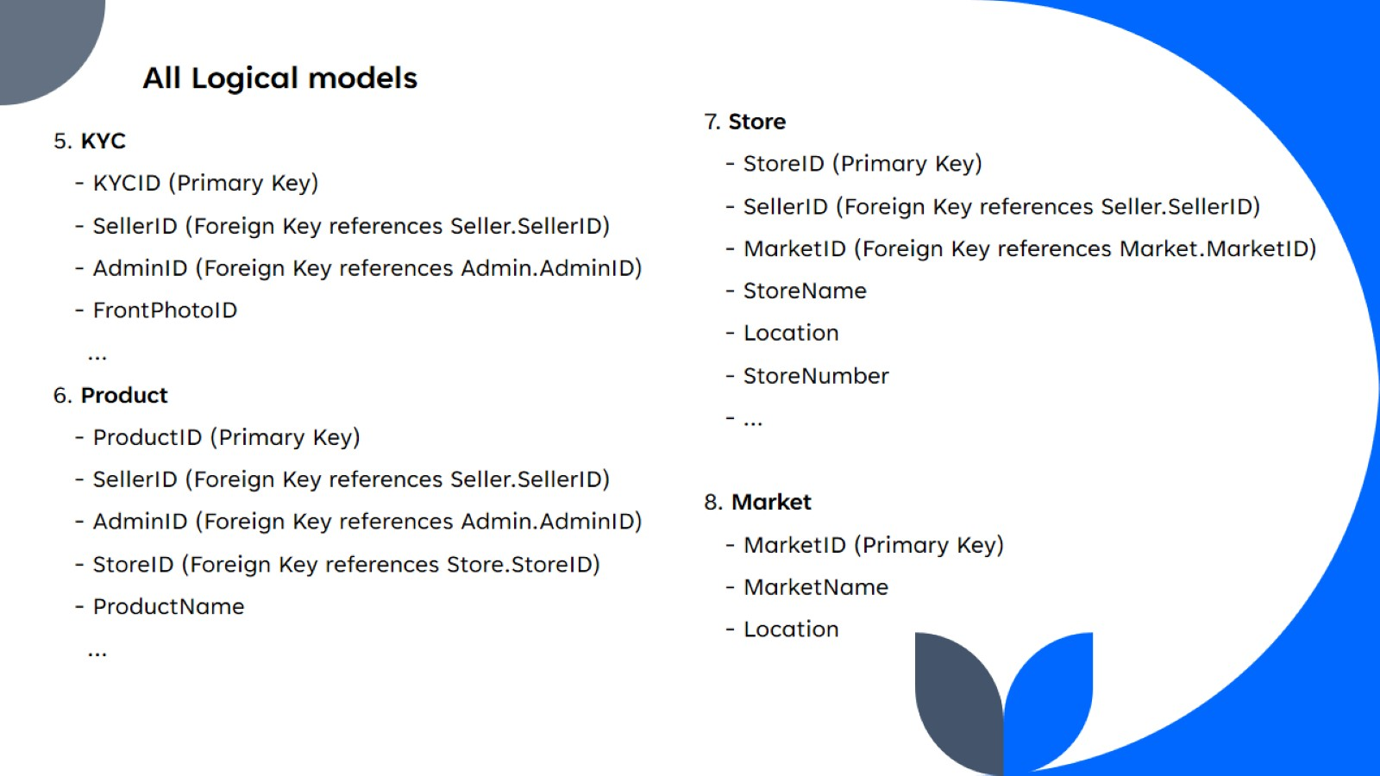
All Logical models

Slide 10
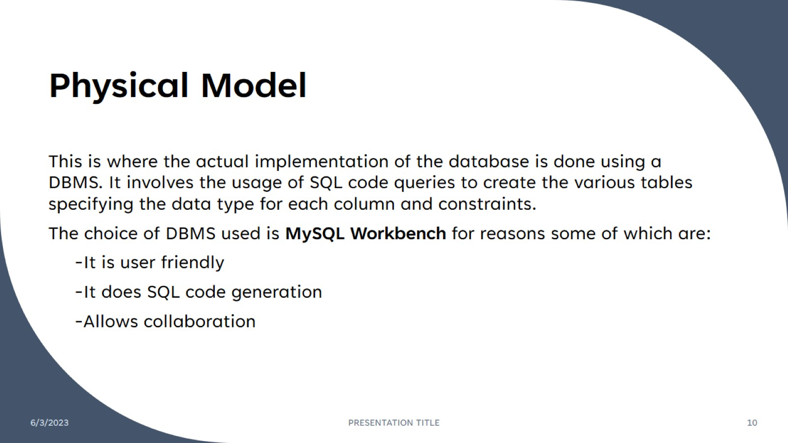
Physical Model

Slide 11
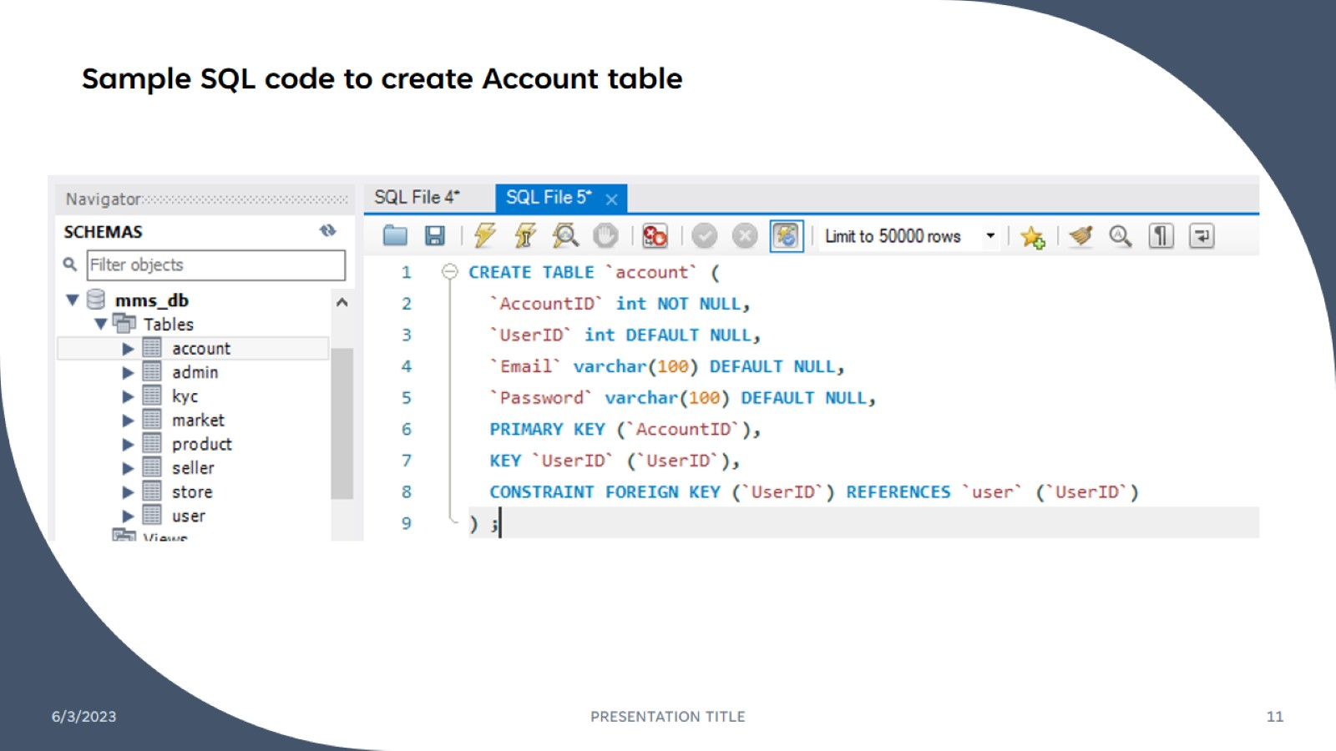
Sample SQL code to create Account table

Slide 12
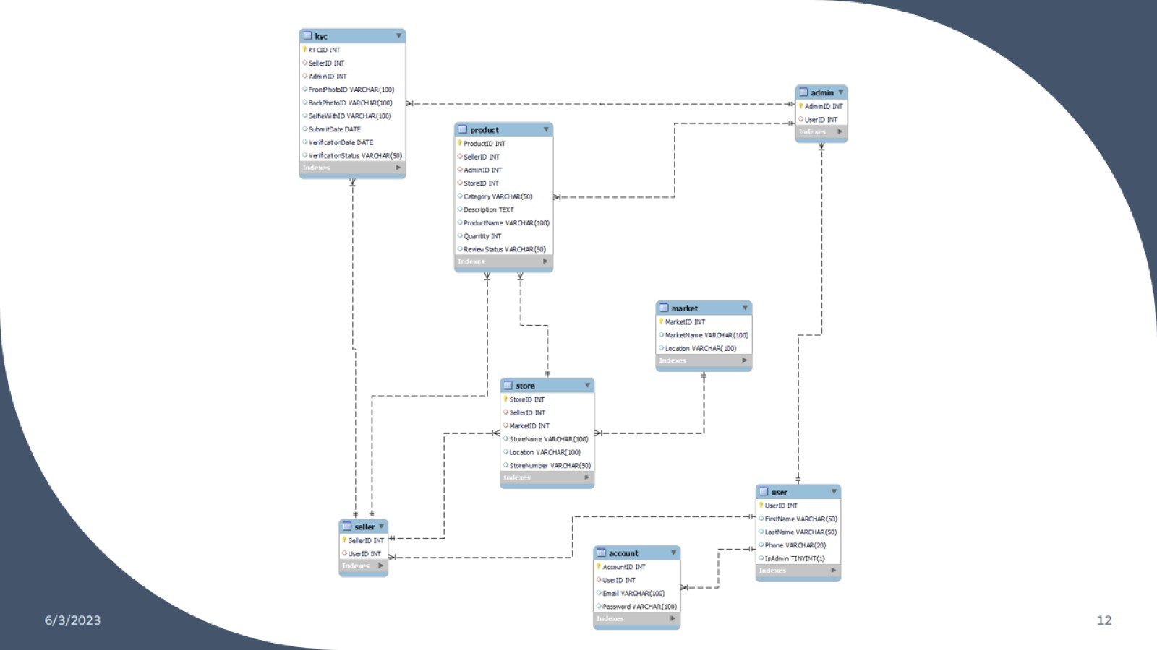

Slide 13
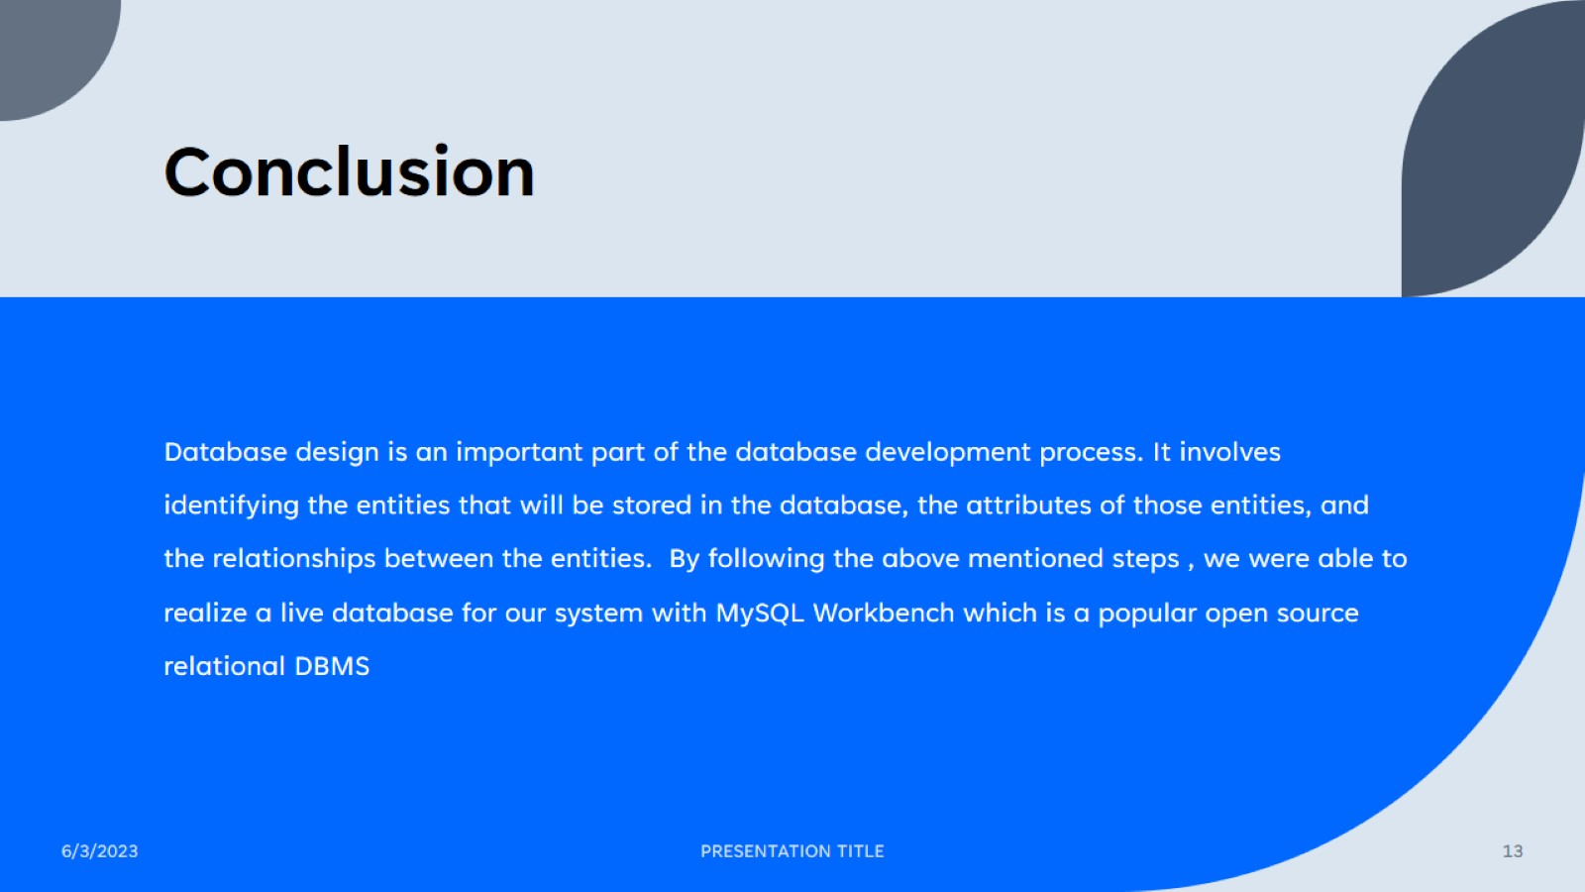
Conclusion

Slide 14

Thank you

